Slide 1

WSO2 API Manager 4.2.0 Developer Advanced
API Manager Runtime
WSO2 Training

Slide 2
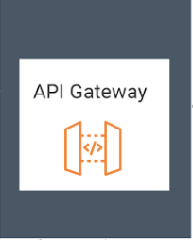




API Runtime Overview (JWT token)
{1}
{2}
{4}
{3}
{app_user}
{application}
{services}
Notes:
When invoking an API exposed via API Runtime (Gateway), application user/ application calls the gateway with access token.
The Gateway validates the JWT token and upon a successful key validation, gateway forwards the request to the respective back-end service.
If the key validation fails, gateway responds back to the user/ app with unauthenticated response.
Back-end service sends the response to the gateway
Gateway sends the response back to the client.

Slide 3
API Gateway

Slide 4
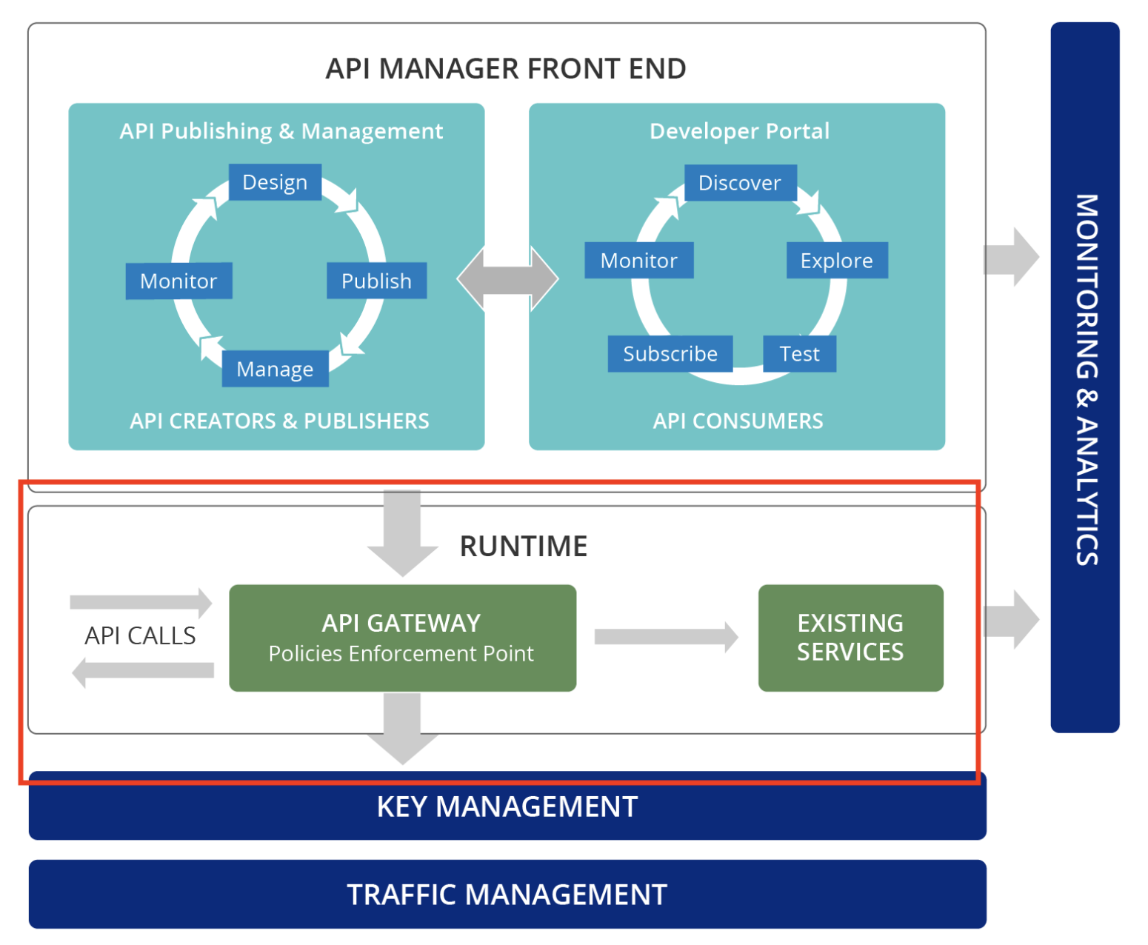
API Gateway Overview
Overview of the API Gateway

Slide 5
WSO2 API Gateway
WSO2 API Gateway, which is powered by Apache Synapse, is an API proxy which enforces policies for API requests.
It secures and manages API calls by intercepting API requests and applying policies such as rate limiting, message mediation and security using handlers and managing API statistics.
After validating all policies, the Gateway passes API calls to the actual back end.
When the API Manager is running, you can access the Gateway via https://<GW_HOST>:8243 or http://<GW_HOST>:8280.

Slide 6
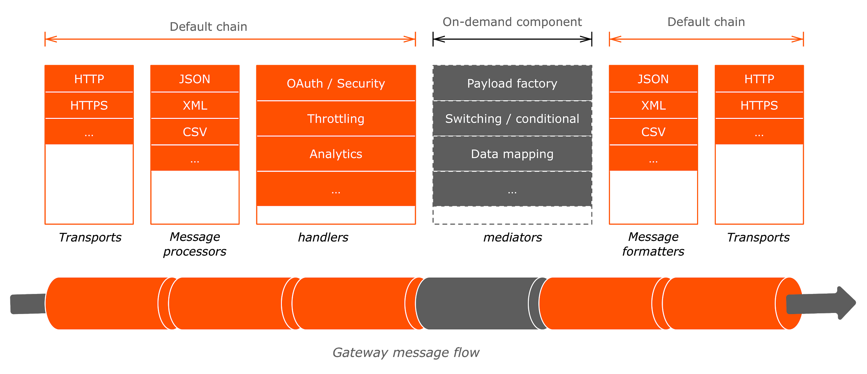
API Gateway Architecture

Slide 7
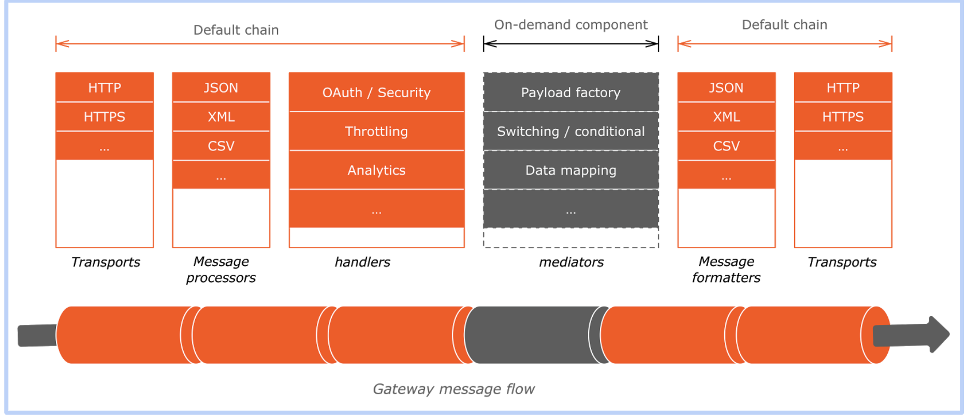
Component | Usage
Transports | When an API request first hits the WSO2 API Gateway it is received by the HTTP/HTTPS transports. The transport is responsible for carrying messages that are in a specific format. The transport provides a receiver, which is used to receive messages, and a sender, which is used to send messages.
Message Processors | Then the receiving transport selects a message builder based on the message's content type. It uses the builder to process the message's raw payload data and convert it into a common XML, which the Gateway mediation engine can then read and understand. The Gateway includes message builders for text-based and binary content.
Handlers | Then the request is passed through a set of handlers that applies the quality of services on the request message. Further, it enforces security, rate-limiting,, and transformations if any on API requests while feeding valuable information of these requests to API Analytics.

Slide 8
Component | Usage
API Policies (Mediators) | After the handlers, the message is passed to the mediators. Any custom mediation sequence will be applied as an API Policy. You can change the message type, set header, set payload, etc.
Message Formatters | After mediators, the message is passed to the message formatters. Message formatters are used to convert the message type to proper format that needs to be sent to the backend. A message formatter is selected based on the message's content type.

Slide 9
WSO2 API Gateway
In the end, the request is routed to the backend endpoint.
Conversely, before transport sends a message out from the Gateway, a message formatter is used to build the outgoing stream from the message back into its original format.
As with message builders, the message formatter is selected based on the message's content type.
Message building and formatting only occurs if there is a content-aware mediator (i.e., reading the request payload) in the flow.

Slide 10
Main Features of the API Gateway
The Gateway supports the below features to control access and enforce security.
Supports multiple API types: REST, SOAP, AsyncAPIs (WebSocket/SSE, WebSub).
Supports JWT, OAuth2.0, Basic Auth, API Key, Mutual TLS, and custom authentication schemes.
Validate API payload contents against schemas.
Apply additional security policies to APIs (authentication and authorization).
Supports all standard OAuth2.0 grant types and allows extensions and additions to grants.
Works seamlessly with third-party OAuth2.0 providers, standard, or proprietary.
Allows blocking subscriptions due to non-payment, API abuse, etc.
Associate API to system-defined service tiers for quotas and rate-limits.
Generate JSON web tokens for consumption by back-end services.
Leverage XACML for entitlement management and fine-grained authorization.
Threat protection, bot detection, and token-fraud detection.
Supports detection of abnormal system use through artificial intelligence and machine learning.

Slide 11
Gateway Request Flow
Client
APIMgtLatencyStatsHandler
Handles API request initiation
CORS Request Handler
Handle CORS Request
API Status Handler
Handles Authentication And Authorization
API Authentication Handler
Handle API Rate Limiting
Throttle Handler
Handle Custom and Global IN Sequences
API Manager Extension Handler
Resource
API Resource In Sequence
Endpoint
Backend

Slide 12
Gateway Response Flow
Back end
APIMgtLatencyStatsHandler
CORS Request Handler
Throttle Handler
API Manager Extension Handler
Handle Custom and Global OUT Sequences
API Resource Out Sequence
Client

Slide 13
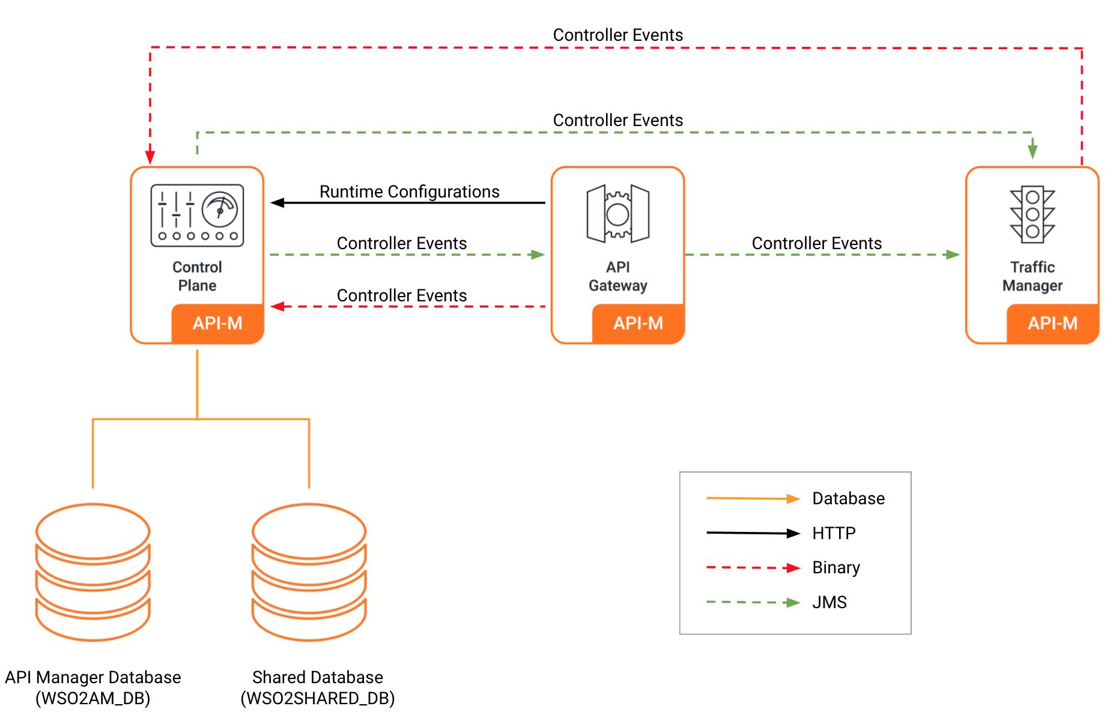
Gateway API Deployment
Notes:
What happens when gateways start
Gateways are subscribed to the Control plane. There is an extension in the Gateway to get the Synapse artifacts and deploy them in the memory. At startup, the Gateway will look for the APIs with labels that it is subscribed to in the configured extension, and fetch the Synapse artifacts of those APIs. Those Synapse artifacts will get deployed in the Gateway.
How API Artifacts get deployed
Create API Revision triggered from the publisher portal
Persist API Revision in registry and related artifacts in DB
Deploy API Revision triggered from the publisher portal
An event will be sent with the API Name, UUID, and the Gateway label of the API.
The API Gateway will filter out the events by the Gateway label.
The Gateway will request for the artifacts related to the event received from the Control plane.
Control plane fetches the artifacts from the database and respond back to the gateway.
The Gateway will receive the artifacts and deploy. If the API is already deployed in the Gateway, it will first undeploy the API and redeploy with the retrieved artifacts.

Slide 14
Gateway REST API
POST /redeploy-api Redeploy the API in the Gateway
POST /undeploy-api Undeploy the API in the Gateway
GET /server-startup-healthcheck Healthcheck to check if all the APIs are deployed during the server startup
GET /api-artifact Get API synapse definition from the storage
GET /local-entry Get Local Entry from the storage
GET /sequence Get sequences from the storage
GET /end-points Get endpoints from the storage for the API
GET /apis Get the list of APIs by providing context and version
GET /apis/{apiId} Get the subscription information of an API by providing the API uuid
GET /applications Get the applications information by providing the application name or uuid
GET /subscriptions Get the subscriptions meta information of an API by providing the API uuid
and application uuid
Link : Gateway REST API v2
Notes:
Since the API synapse artifacts are no longer saved in the file system, users can use the gateway REST API to fetch the API, local-entry, sequence and endpoint artifacts etc. from the storage.

Slide 15
Extension Points
WSO2 API Manager Gateway is highly extensible. Several extensions can be done as follows.
Custom Message Builders and Formatters
Examples:
Engaging a new content type
Link: Writing a Custom Message Builder and Formatter
Custom API Policies
Examples:
Adding a custom API Policy for Choreo Connect
Link: Create a Custom Choreo Connect Policy
Notes:
WSO2 API Gateway is highly extensible.

